Slide 1
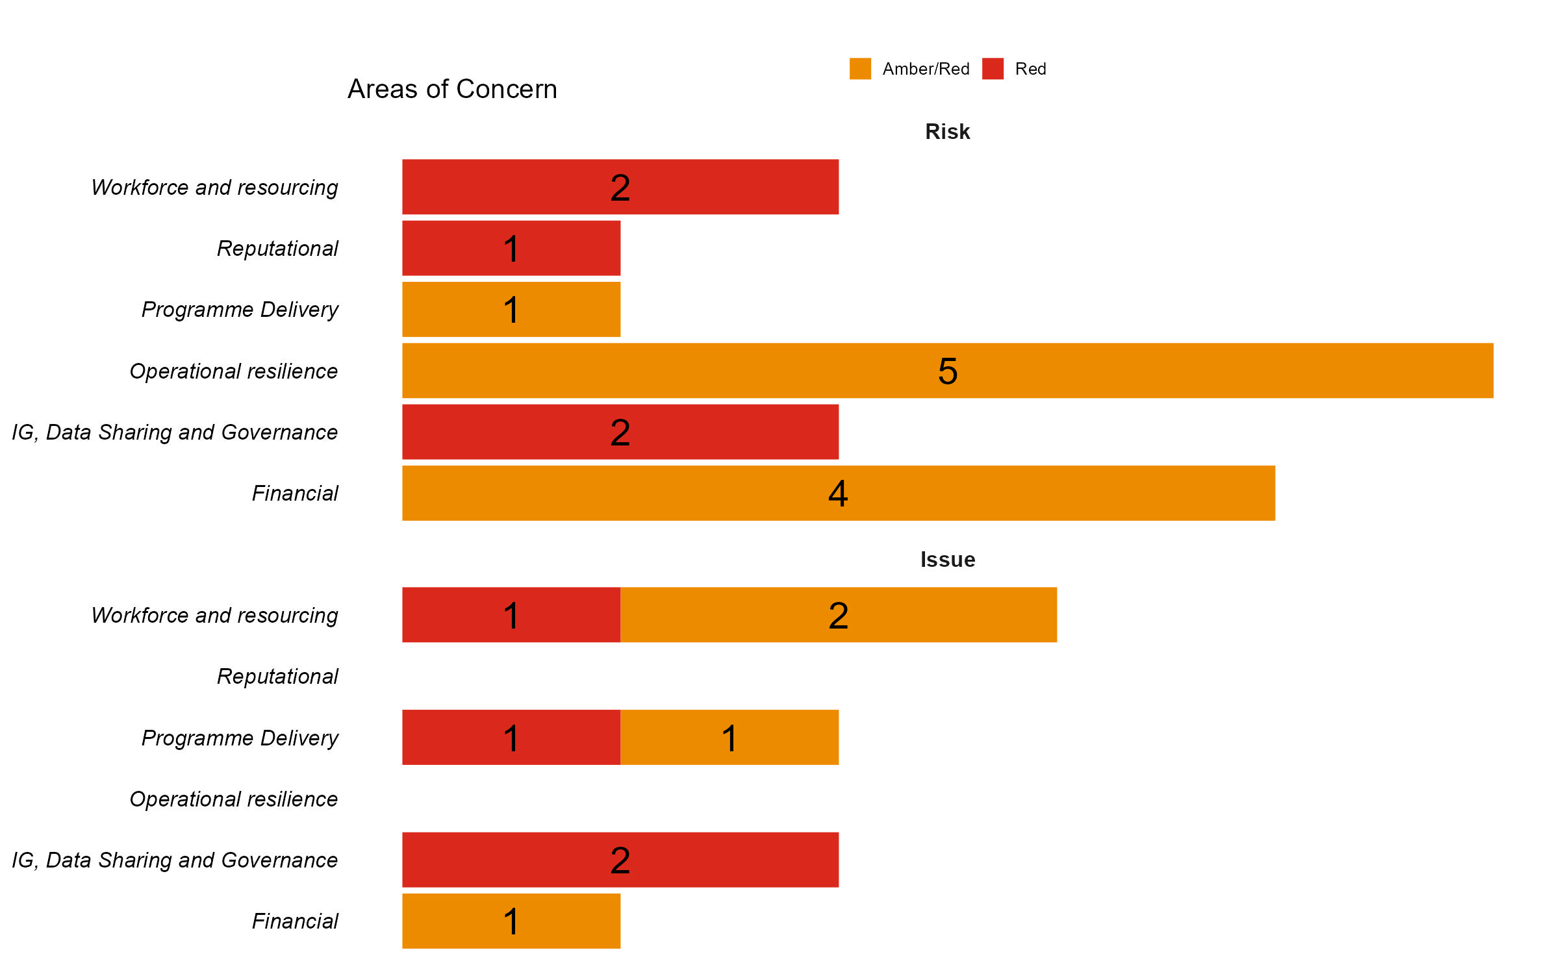
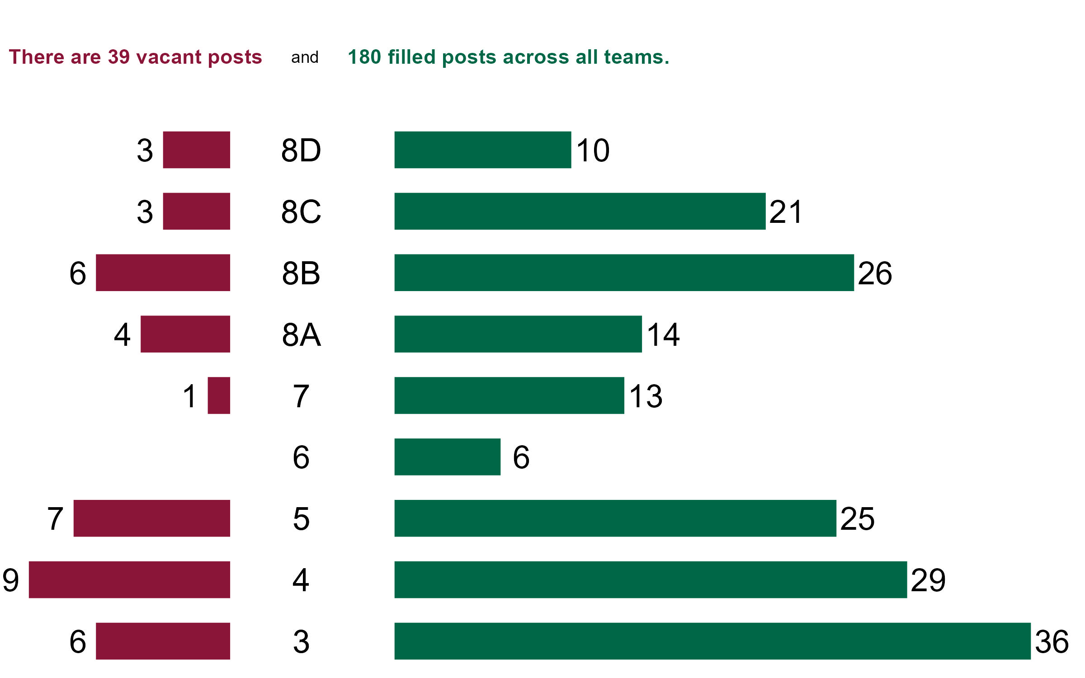
Sample Summary Slide
Programme 1 | Green | 58
doughnut supply | Amber | 49
staff satisfaction | Green | 68
R useage | Green | 82
Programme 2 | Amber | 10
chocolate supply | Red | 52
staff satisfaction | Red | 45
Excel useage | Amber | 43
Programme 3 | Amber | 77
useful reports | Green | 75
Programme 4 | Green | 56
time freed up by automation | Green | 63
additional requests prompted by fabulous reports | Green | 68
R useage | Green | 90

